Slide 1


Job Analysis: Insights from Scraped Data
This presentation explores into the analysis of job data scraped from Naukri.com, providing insights into the Indian job market.
by Karuppasamy.S

Slide 2


Scraping Naukri.com: Methodology and Data Collection
1
Web Scraping Techniques
2
Data Extraction
3
Data Storage
Utilizing libraries such as Beautiful Soup and Selenium, we scraped job postings, including job titles, descriptions, locations, and company details.
We carefully identified and extracted relevant data elements from the HTML structure of Naukri.com's job pages.
Scraped data was stored in structured formats like CSV files or excel files for subsequent processing and analysis.

Slide 3
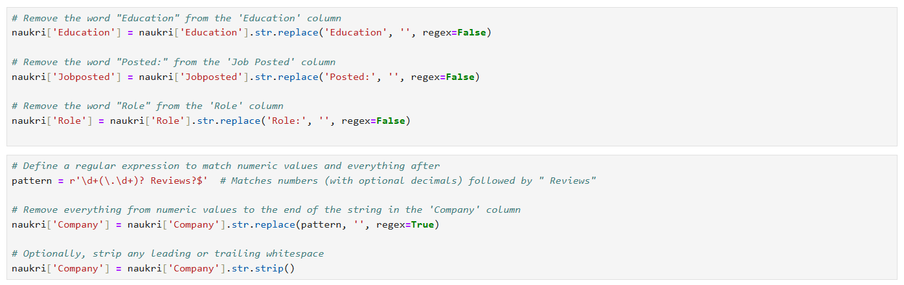

Data Cleaning in Python
In data cleaning, I checked for null values in the dataset, removed any rows or columns with null values, and eliminated unwanted or irrelevant data.

Slide 4

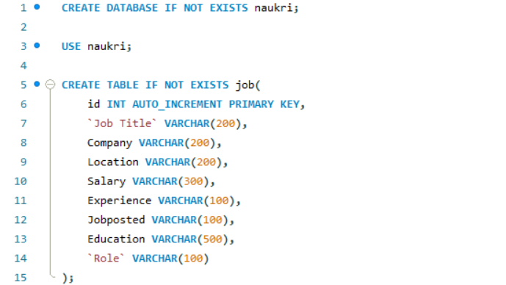

Pushing Cleaned Data into SQL: Creating a Database
Used a SQL connector to transfer data from Python to a SQL database.

Slide 5
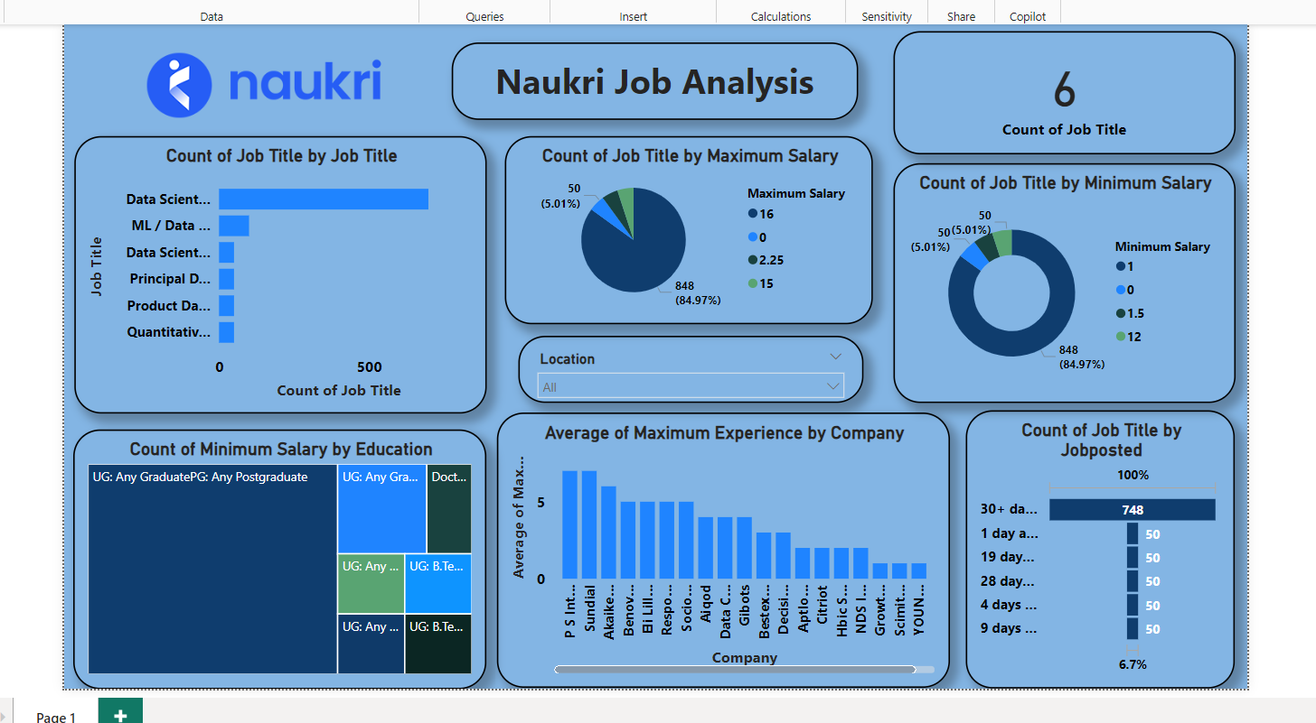
Visualization with Power BI: Dashboards and Reports

Slide 6

Conclusion
Important job market data was collected by scraping the Naukri website, which helped analyze trends, skills in demand, and salary ranges, providing a clear picture of the current job market.
Thank You

